Slide 1
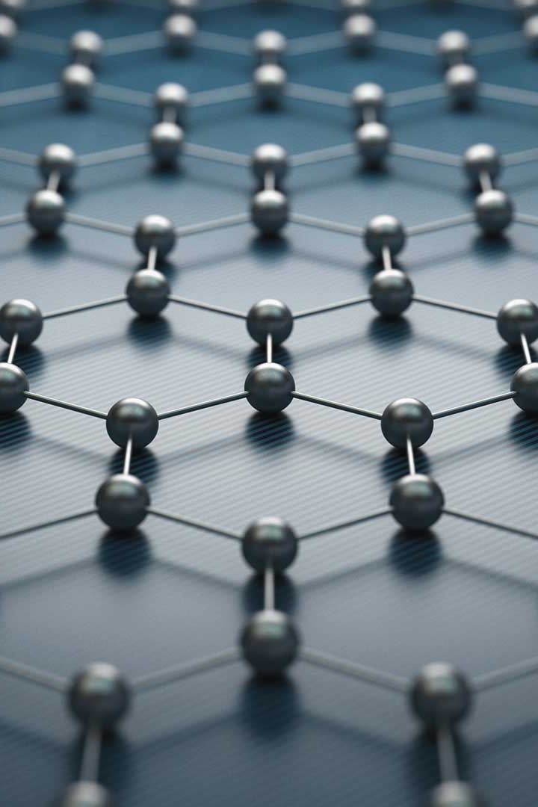
Graphene Batteries: The Future of Energy Storage
Discover the amazing potential of graphene batteries, a revolutionary technology that promises to transform the way we store and use energy.
Presented by ,
ABHINANDH S S(URK22CS1153)
ANSON SAJU GEORGE(URK22CS7064)
PIOUS JOSE GEORGE(URK22CS2050)
JERIL JOSEPH (URK22CS7086)

Slide 2

What is Graphene?
Graphene is a single layer of carbon atoms arranged in a two-dimensional honeycomb lattice. It is the thinnest, lightest, and strongest material ever discovered. With remarkable electrical and thermal properties, graphene is revolutionizing various industries.

Slide 3
Properties of Graphene
Conductivity
Strength
Graphene exhibits exceptional electrical conductivity, allowing it to efficiently transport and store energy.
Graphene is incredibly strong, making it resistant to damage and deterioration, enhancing the longevity of batteries.
Flexibility
Transparency
Graphene's flexibility allows it to be integrated into a wide range of form factors, ideal for compact energy storage solutions.
Graphene is transparent, making it suitable for applications requiring see-through displays or energy-capturing windows.

Slide 4

Advantages of Graphene Batteries
1
Fast Charging
2
High Energy Density
3
Long Cycle Life
Graphene batteries can be charged at an incredibly high rate, reducing waiting time and improving convenience.
Graphene batteries offer a higher energy density than traditional lithium-ion batteries, enabling more power in a smaller footprint.
Graphene's durability allows batteries to endure thousands of charge-discharge cycles without significant capacity loss.

Slide 5

Current Challenges in Graphene Battery Technology
1
Cost
2
Scaling Up
3
Stability
Graphene production remains expensive, inhibiting widespread adoption of graphene batteries.
Scaling up production to meet global energy demands is a significant challenge due to complex manufacturing processes.
The stability of graphene-based electrodes under different operating conditions needs further improvement.

Slide 6
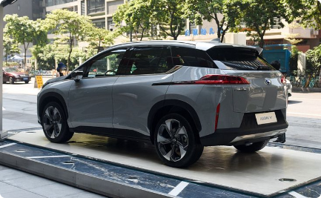
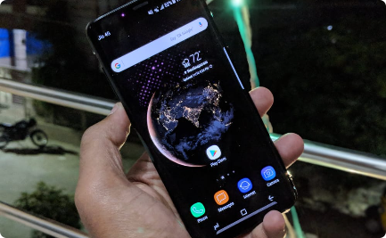
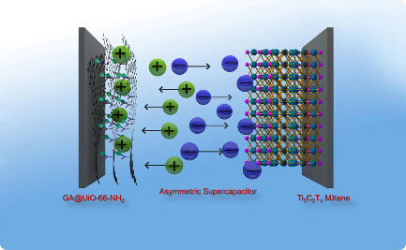
Graphene Batteries in Various Applications
Electric Vehicles
Consumer Electronics
Renewable Energy Storage
Graphene batteries can significantly increase the range and charging speed of electric vehicles, accelerating the transition to sustainable transportation.
Graphene batteries can revolutionize smartphones, providing longer battery life and faster charging for our everyday devices.
Graphene batteries can store excess energy from renewable sources, enabling more efficient and reliable clean energy systems.

Slide 7

Future Potential of Graphene Batteries
1
Advanced Energy Grids
Graphene batteries could revolutionize the power grid, enabling efficient energy distribution and grid-level storage.
Space Exploration
2
Graphene batteries can power spacecraft, offering longer missions and reducing the reliance on traditional power sources.
3
Medical Devices
Graphene batteries could revolutionize medical implants, providing longer-lasting power for life-saving devices.

Slide 8

Conclusion:
The Impact of Graphene Batteries on Energy Storage
Graphene batteries represent a paradigm shift in energy storage, with the potential to transform industries and accelerate the transition to a sustainable future. The possibilities of graphene technology are limitless, and we are just beginning to scratch the surface of its vast potential.

